Slide 1
TEAM INFINITY
TEAM MEMBERS:-
PANTHALA RAJAN - 130
KAVIN - 106
RAHHUL - 146 LOGESHRAM - 117 RAGUPATHI - 145 RAJKUMAR - 148

Slide 2
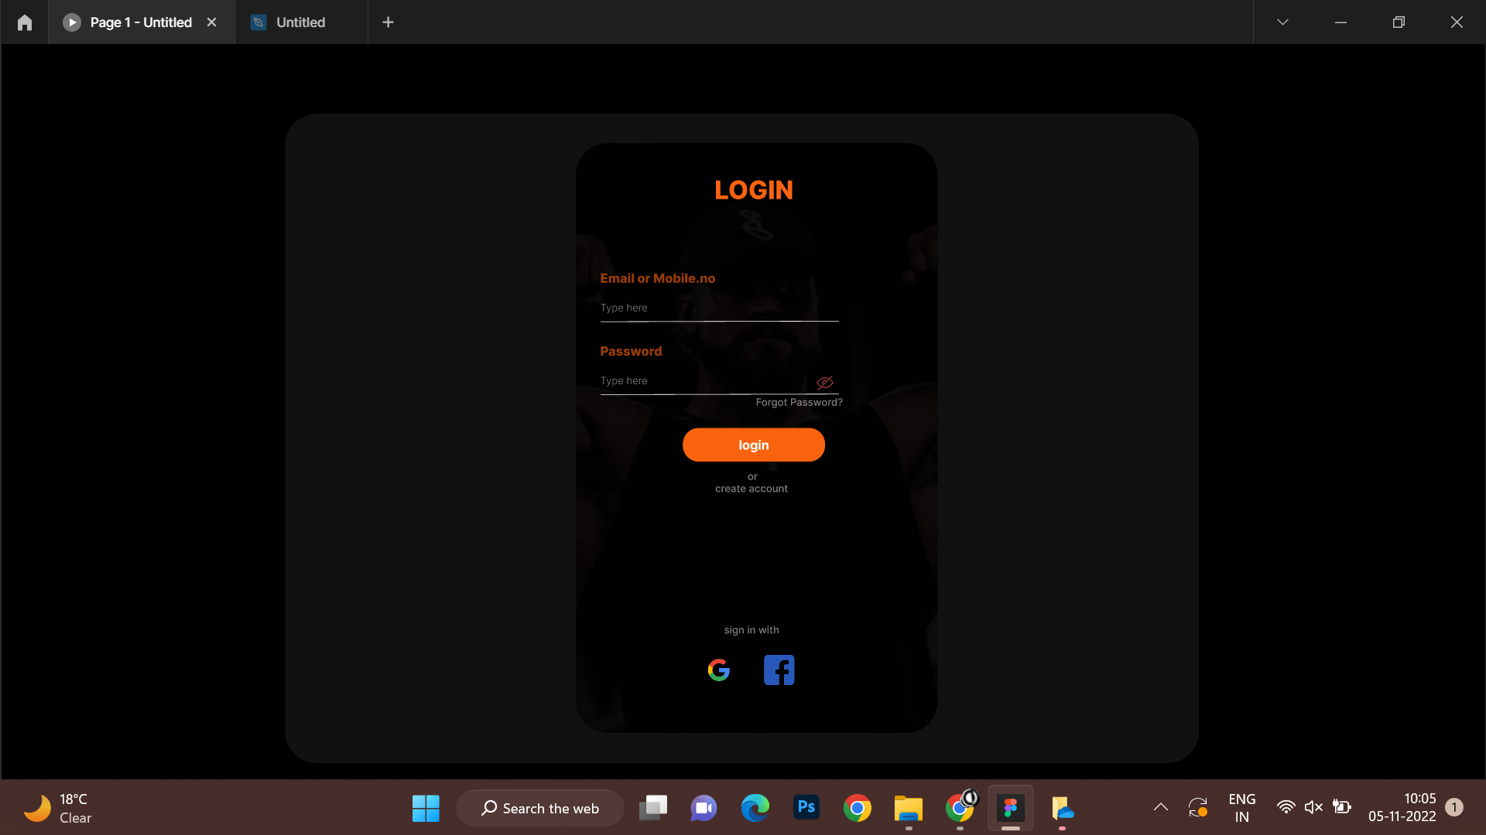

Slide 3
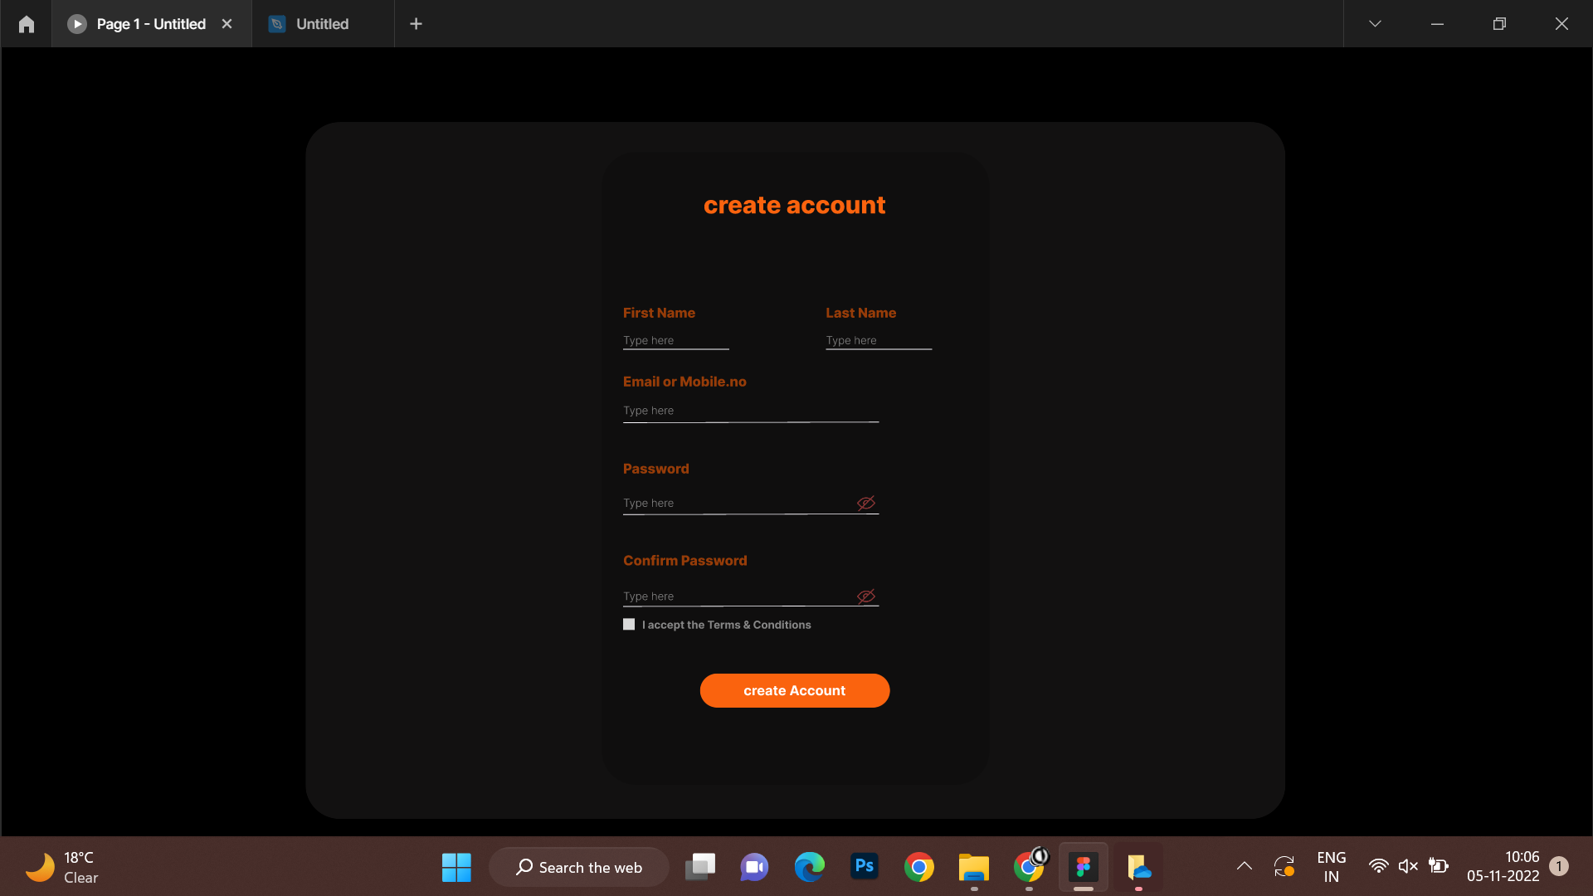

Slide 4
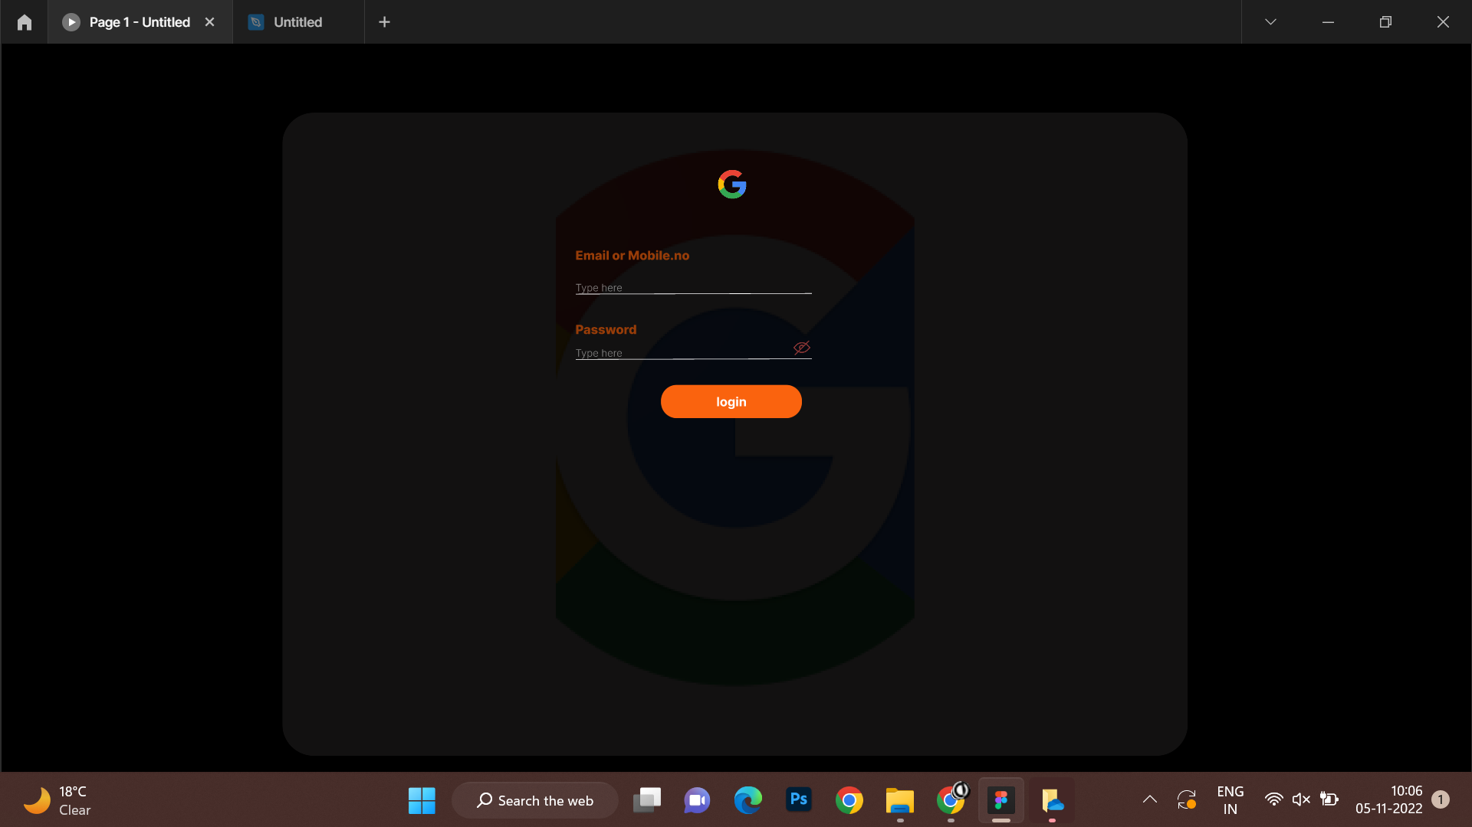

Slide 5
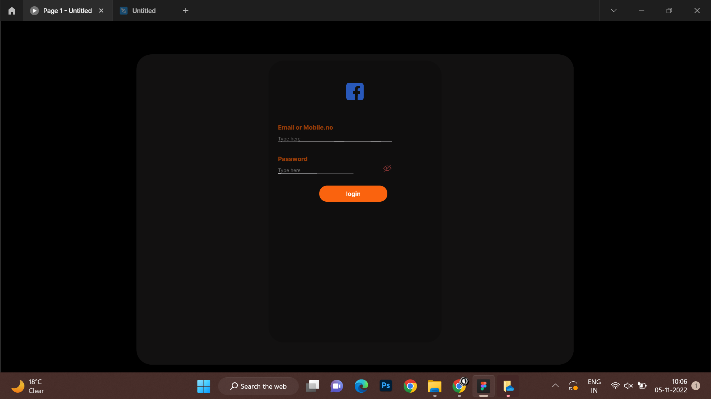

Slide 6
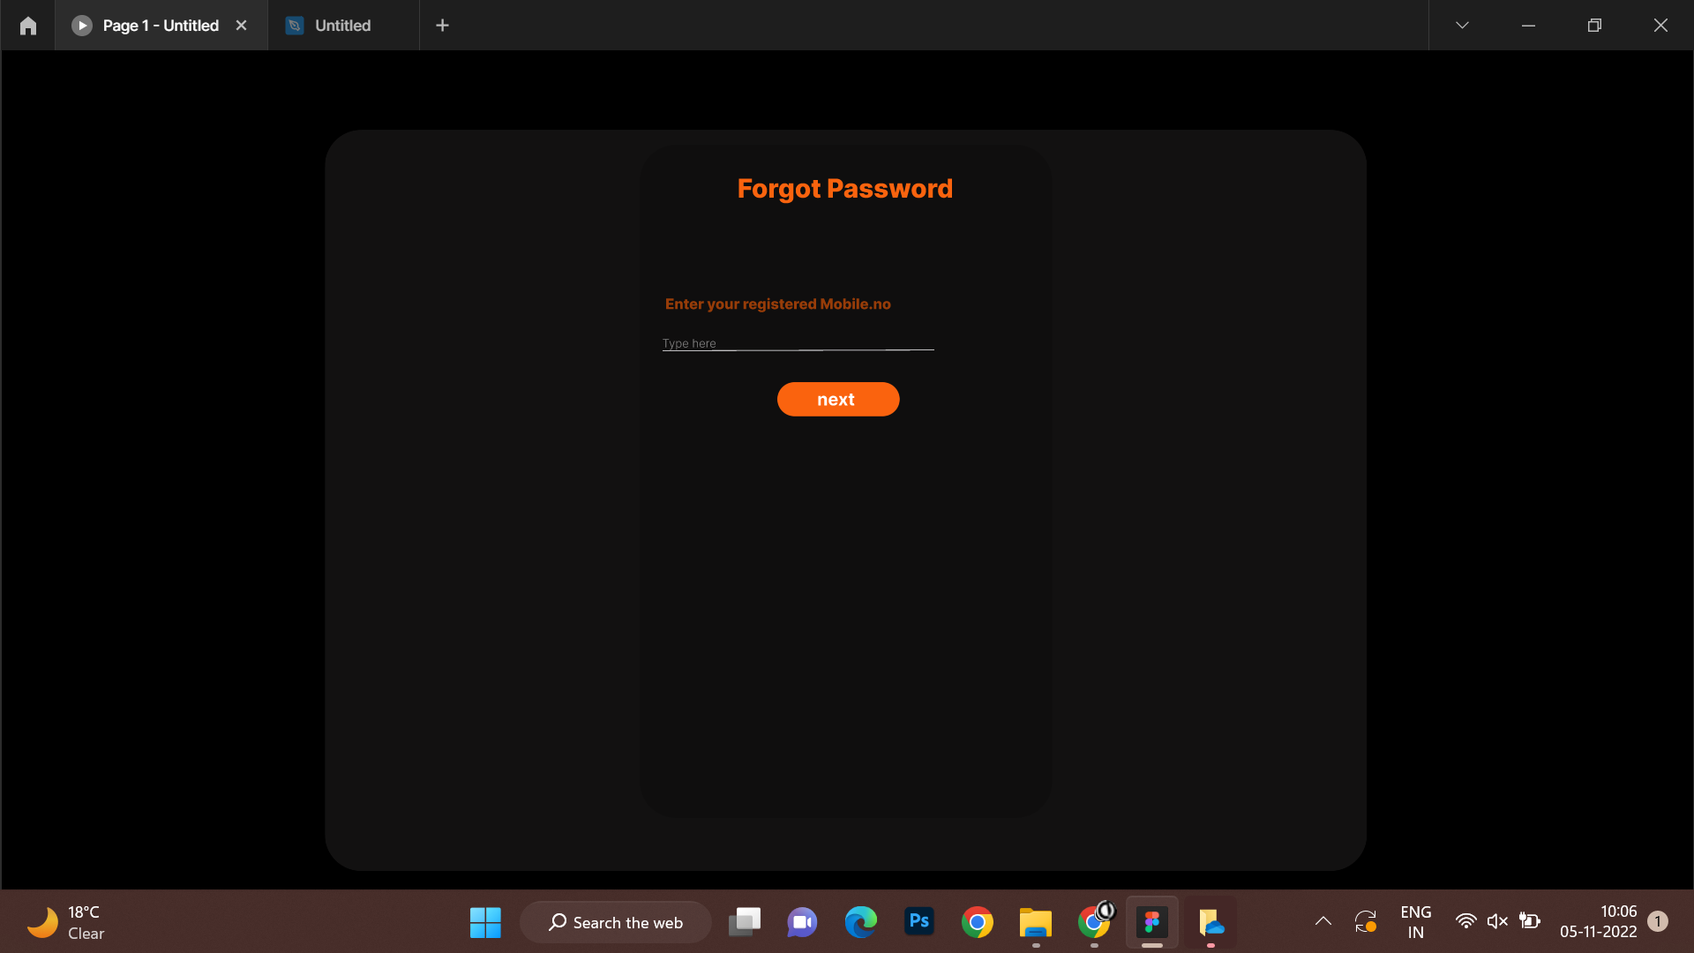

Slide 7
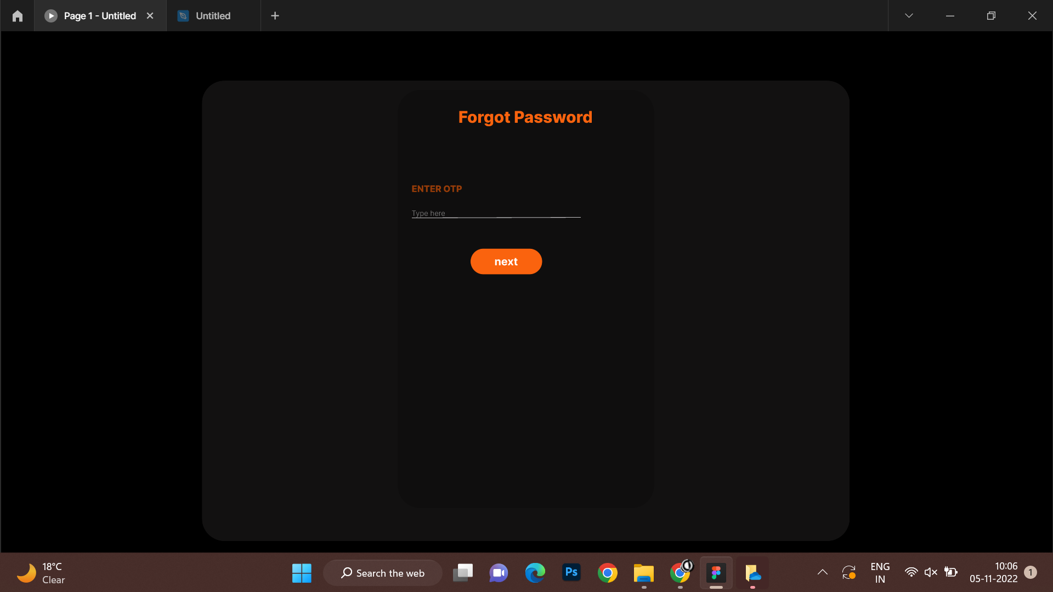

Slide 8


Slide 9
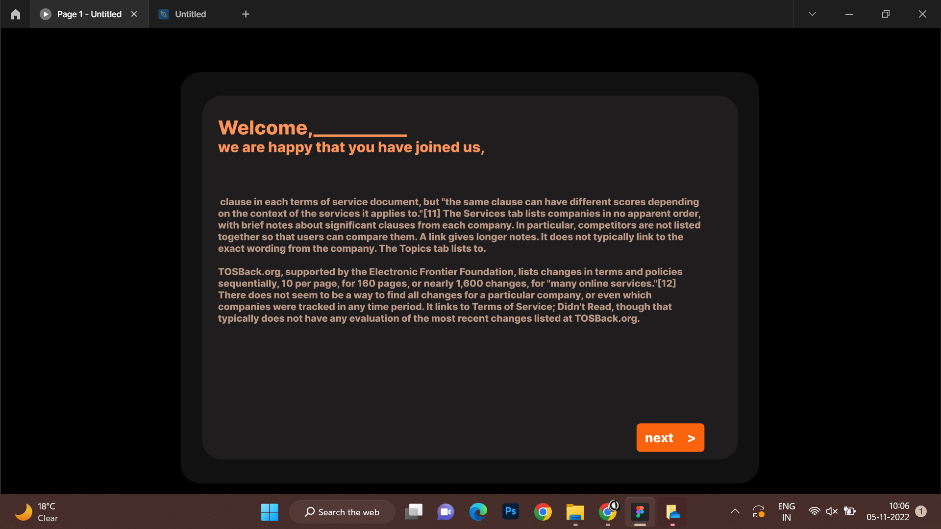

Slide 10


Slide 11


Slide 12


Slide 13


Slide 14
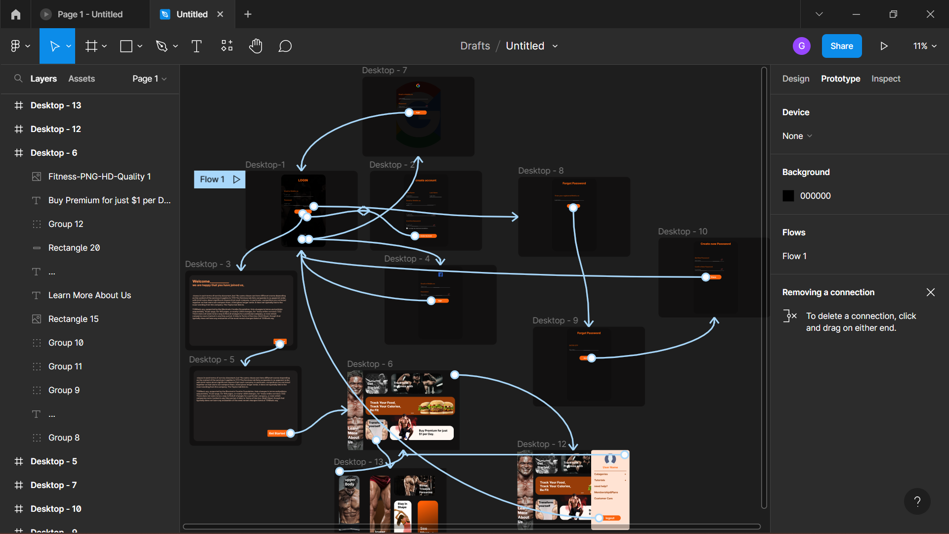

Slide 15
https://www.figma.com/file/x7ZNYT2f8Y48JGv622eM9H/Untitled?node-id=0%3A1
https://github.com/KavinMr/Fitness.git

